Slide 1
Uber Supply-Demand
Gap
By:- Rohan Daniel

Slide 2
Problem Statement:
Driver Cancellations and Non-Availability of cabs to and from Airport leading to loss of potential revenue.
Business Objective:
To identify the Supply-Demand gap in cabs from Airport to City and vice-versa.
Research Questions:
Identify the most pressing problems for Uber
What is the gap between supply and demand to and from Airport
What might be the reason for this supply-demand gap?
Recommend some ways to improve the supply-demand gap.
Data Used for Analysis:
The data used is only to and from Airport.

Slide 3
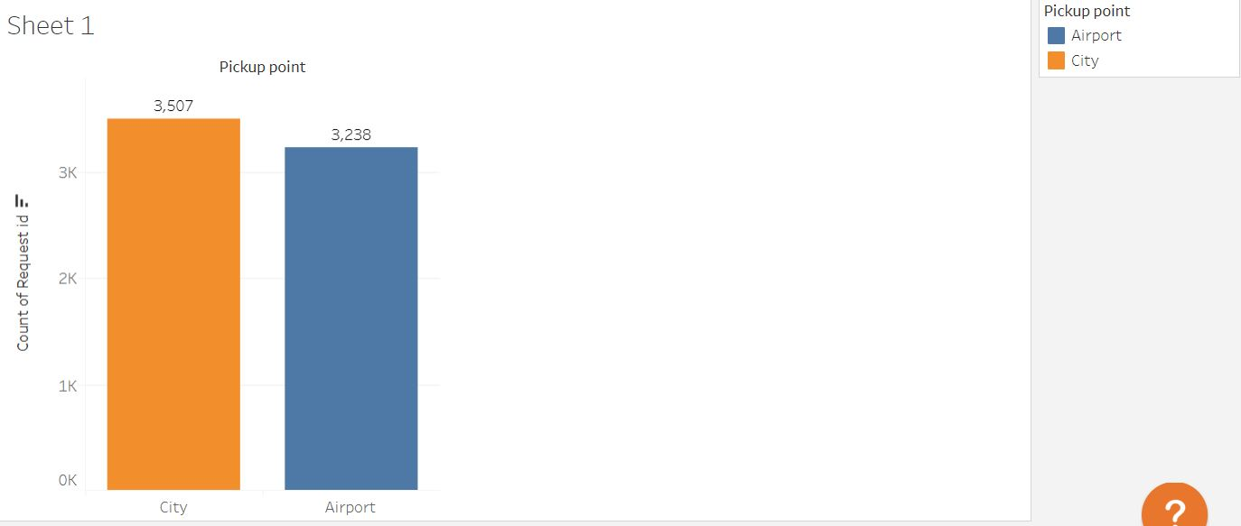
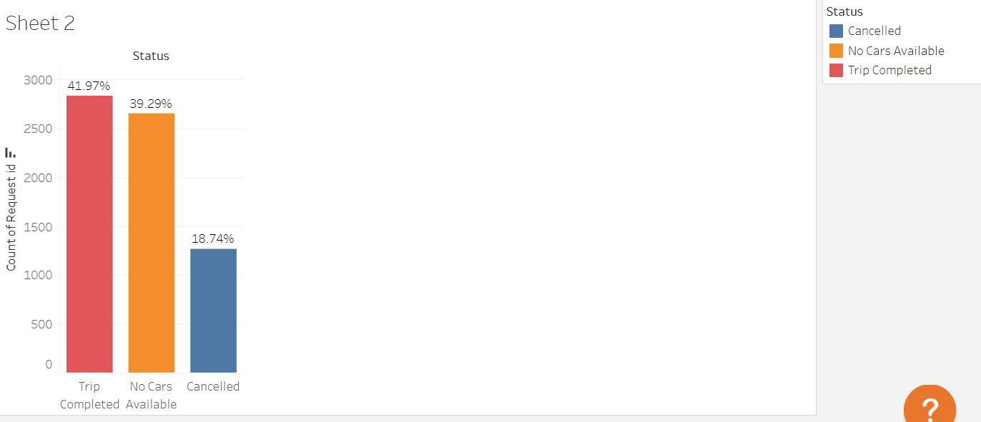
The Problem:
The Demand for cabs is equivalent both from Airport to City and vice versa.
There is a huge gap in Supply as only about 42% of the requests are fulfilled.
There is a gap of 58% in the supply of cabs.
About 39.3% shortage in cabs availability in the concerned areas and 18.7% trips cancelled.

Slide 4
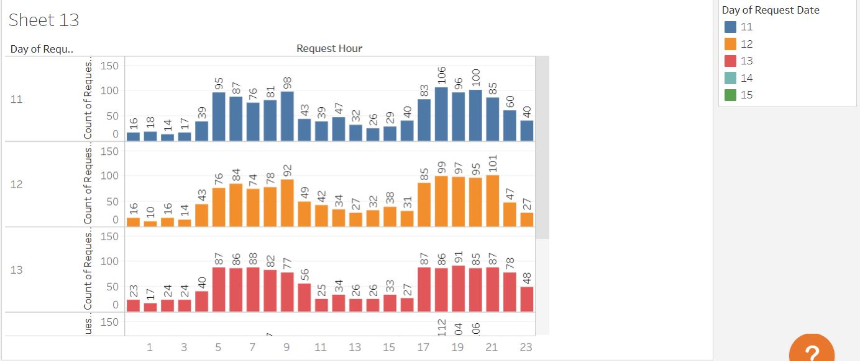
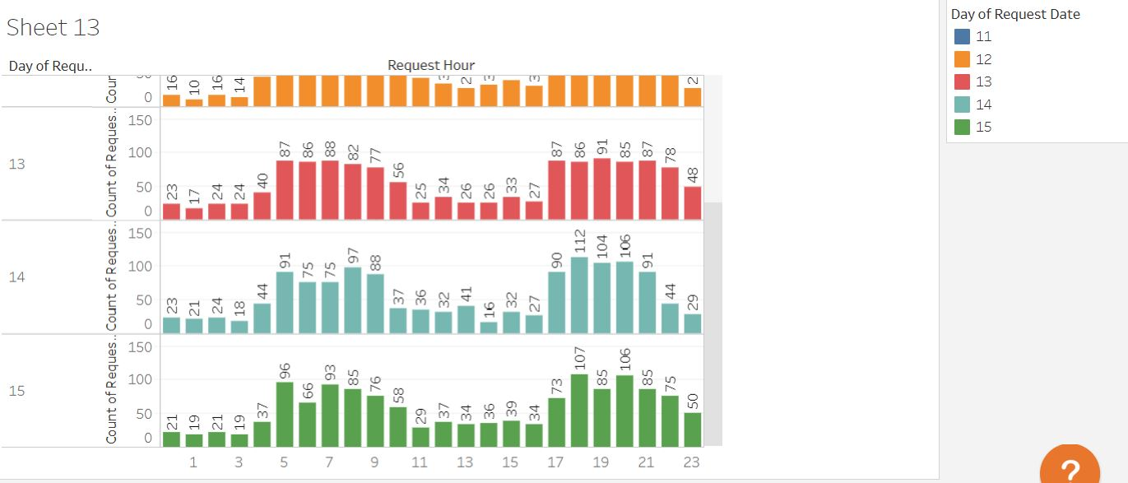
Overall Demand Based on Date and Time
Irrespective of days, it is clearly seen that the demand is high demand of cabs mainly in:
Morning (5am to 10am)
Late Evening and Night (5pm to
11pm)

Slide 5
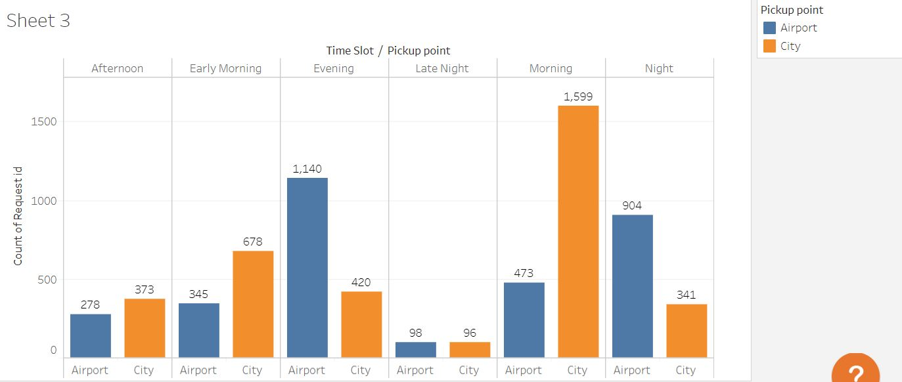
Demand Based on Time and Location
There is a high demand of cabs from City to Airport in the Early Morning and Morning hours.
There is a high demand of cabs from Airport to City in the Evening and Night hours.
This means there are chance of having:
more Outbound flights in the Early Morning and Morning
Hence more customers going to Airport and less customers coming to City,
more Inbound flights in the Evening and Night
Hence more customers coming to City and less customers going to Airport.

Slide 6
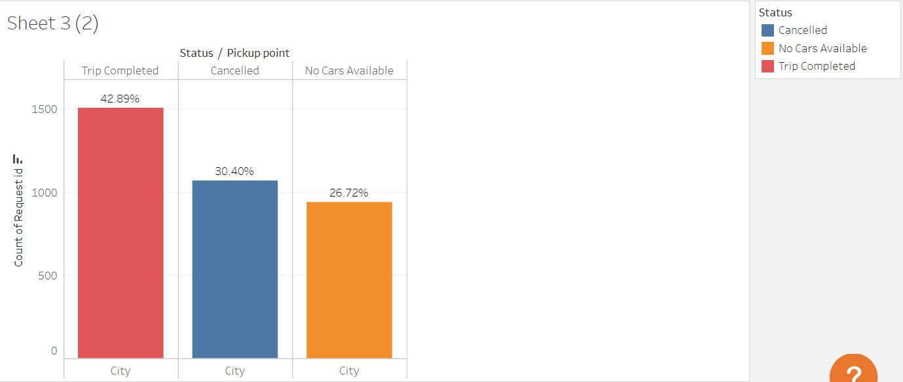
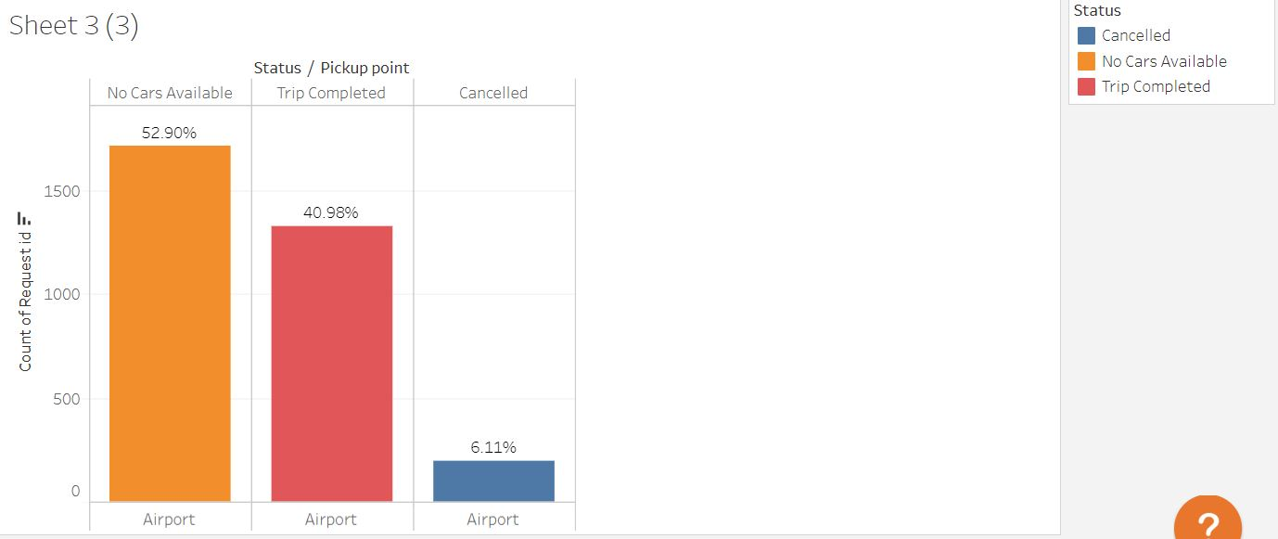
Supply Based on Location
City to Airport :
30.4% requests Cancelled
 Cabs denying services
26.7% face Non-Availability
 Shortage of cabs in city
Airport to City :
52.9% face Non-Availability
 Shortage of cabs around Airport

Slide 7
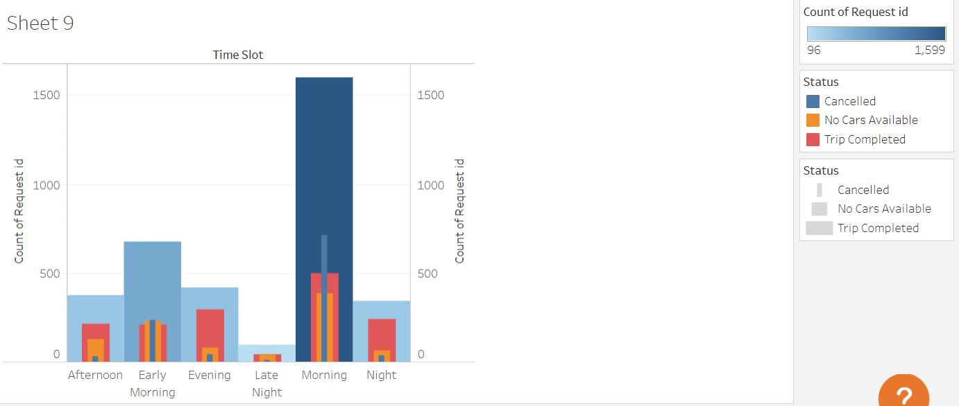
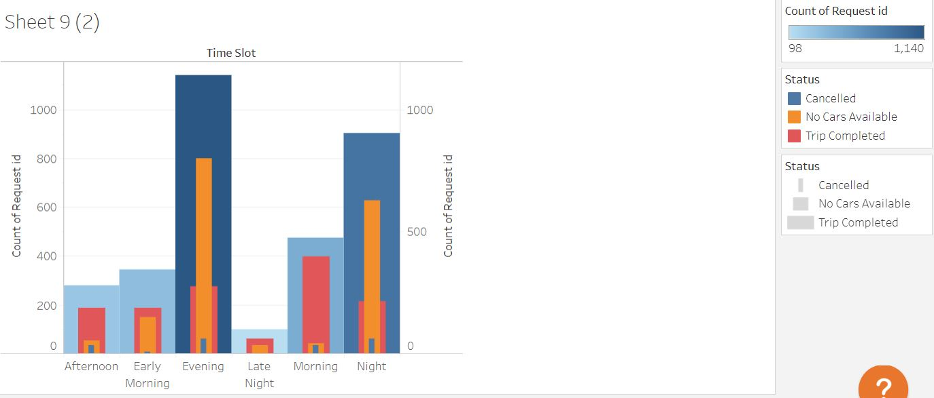
Demand and Supply Gap
City to Airport (Early Morning and Morning):
1. High Demand
2. Low Supply
 Cabs denying services as not enough
demand from Airport to meet the influx of cabs
 Also not enough cabs to meet the demand
Airport to City (Late Evening and Night):
1. High Demand
2. Low Supply
 Not enough cabs go towards Airport to
meet the demands
Of City
Of Airport

Slide 8
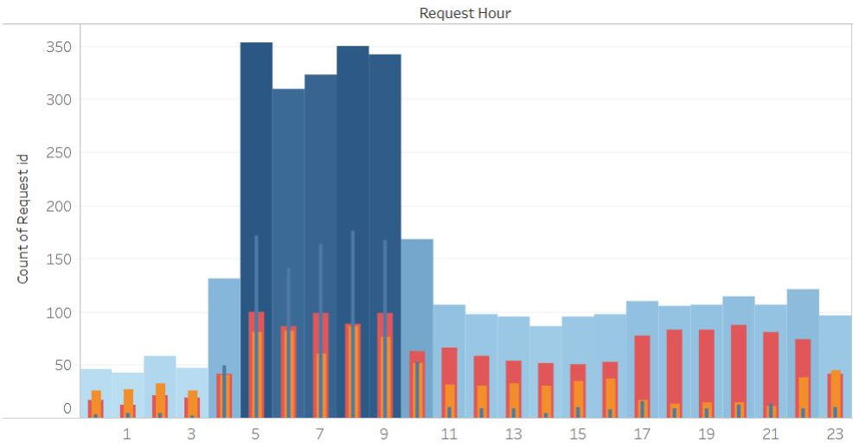
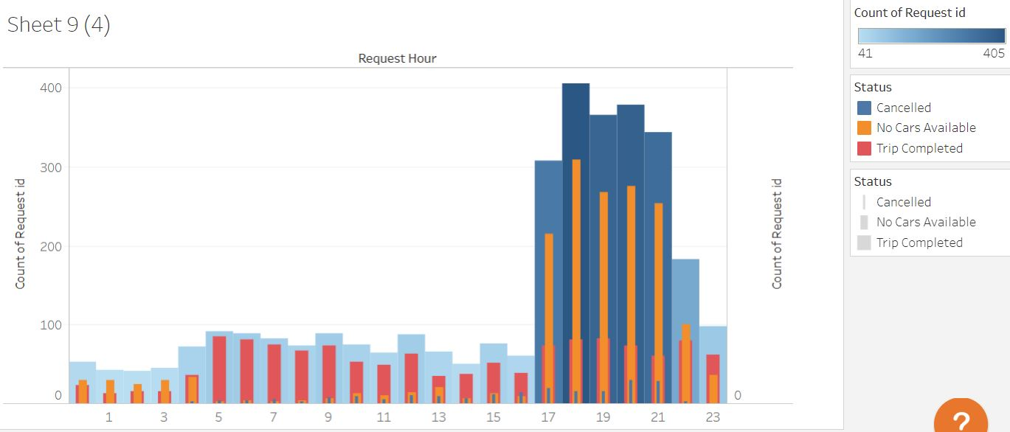
Demand and Supply Gap - The Reason
What is the reason for this supply demand gap?
1. The flow of traffic is one directional due to
flight timings.
 Early Morning and Morning: High
demand from City, but low demand from
Airport. Hence it's risky/less opportunity for drivers to get return trip to City and the trips are cancelled.
 Late Evening and Night: High demand from Airport but not enough cars around as less number of cars go towards airport in
evening.
2. There is a shortage of cabs in general. At the
peak times there is about 26% chance of Non-
Availability of cabs both to and from Airport
Of City
Of Airport

Slide 9
Possible Solutions and Recommendations:
It was found the demand at peak times is mostly unidirectional and demand at destination around that was not enough for return trips for drivers.
 It is recommended to provide incentives to drivers for trips to and from Airport during these rush hours (to 5 am
to 11am and 5pm to 11pm.
 During these rush hour customers can be charged higher for trips to and from Airport.
It was also observed that there is a shortage of cabs in general.
Though the reason of shortage from Airport is not enough organic supply to the airport, but from city as well,
overall about 26.7% requests face Non-Availability of cabs.
 Avg. Non-Availabilty hourly
＊ Airport = 71
＊ City = 39
 Hence based on the available data a new fleet of 40-70 cabs can added to Uber services
The average time of travel is 52.4 minutes for these trips.
 Incentive based on distance of trips will encourage drivers to take these trips. This would make a better financial
sense for drivers.
 Accordingly longer trips should be charged

Slide 10
Incentivising these trips will in turn meet more customer demands, resulting in better profits for Uber.
Educating drivers about these demand-supply gap.

